Slide 1


Packet Inspection to detect attacks using machine learning models
Presentatio
By: Hussein Salloum
Supervised by:
Dr – Sameeh Jammoul
Dr- Mohammad Bashar Dasouki

Slide 2
Project Objective

Slide 3
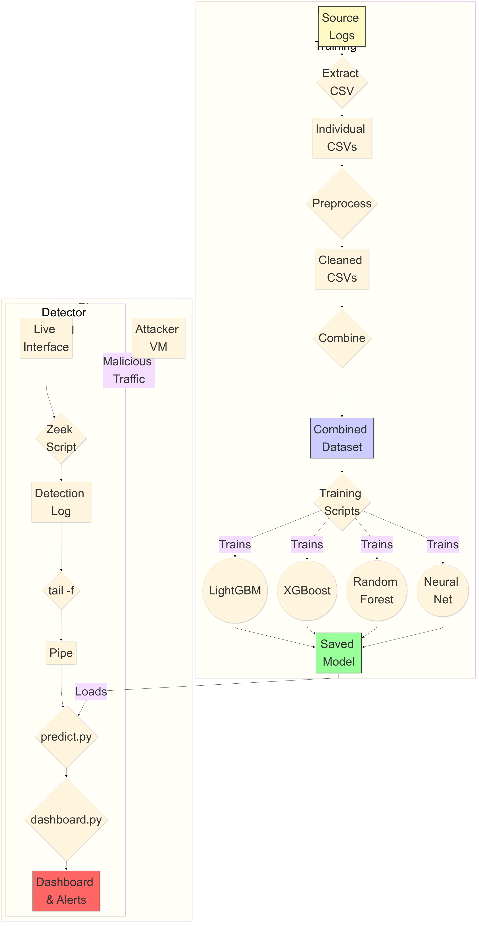

System Block Diagram
1

Slide 4

Preprocessing IoT-23 Dataset
Dataset features: in bold are the used features:
ts ,uid, id.orig_h, id.orig_p, id.resp_h, id.resp_p, proto, service, duration, orig_bytes, resp_bytes, conn_state, local_orig, local_resp, missed_bytes, history, orig_pkts, orig_ip_bytes, resp_pkts, resp_ip_bytes, Label
encoding_map = {
"proto": {"icmp": 0,"tcp": 1,"udp": 2,"UNKNOWN": -1},
"service": {"-": 0,"dhcp": 1, "dns": 2, "http": 3,"ssh": 4,"ssl": 5,
"irc": 6, "UNKNOWN": -1},
"conn_state": {"S0": 0,"S1": 1,"S2": 2,"S3": 3,"SF": 4,"REJ": 5,
"RSTO": 6,"RSTR": 7,"RSTOS0": 8,"RSTRH": 9,"SH": 10,"SHR": 11,
"OTH": 12,"UNKNOWN": -1}}
Handling nan values for {'duration', 'orig_bytes', 'resp_bytes’} features:
Conn_state=0 ➔ 0s conn_satae!=0 ➔ medians

Slide 5
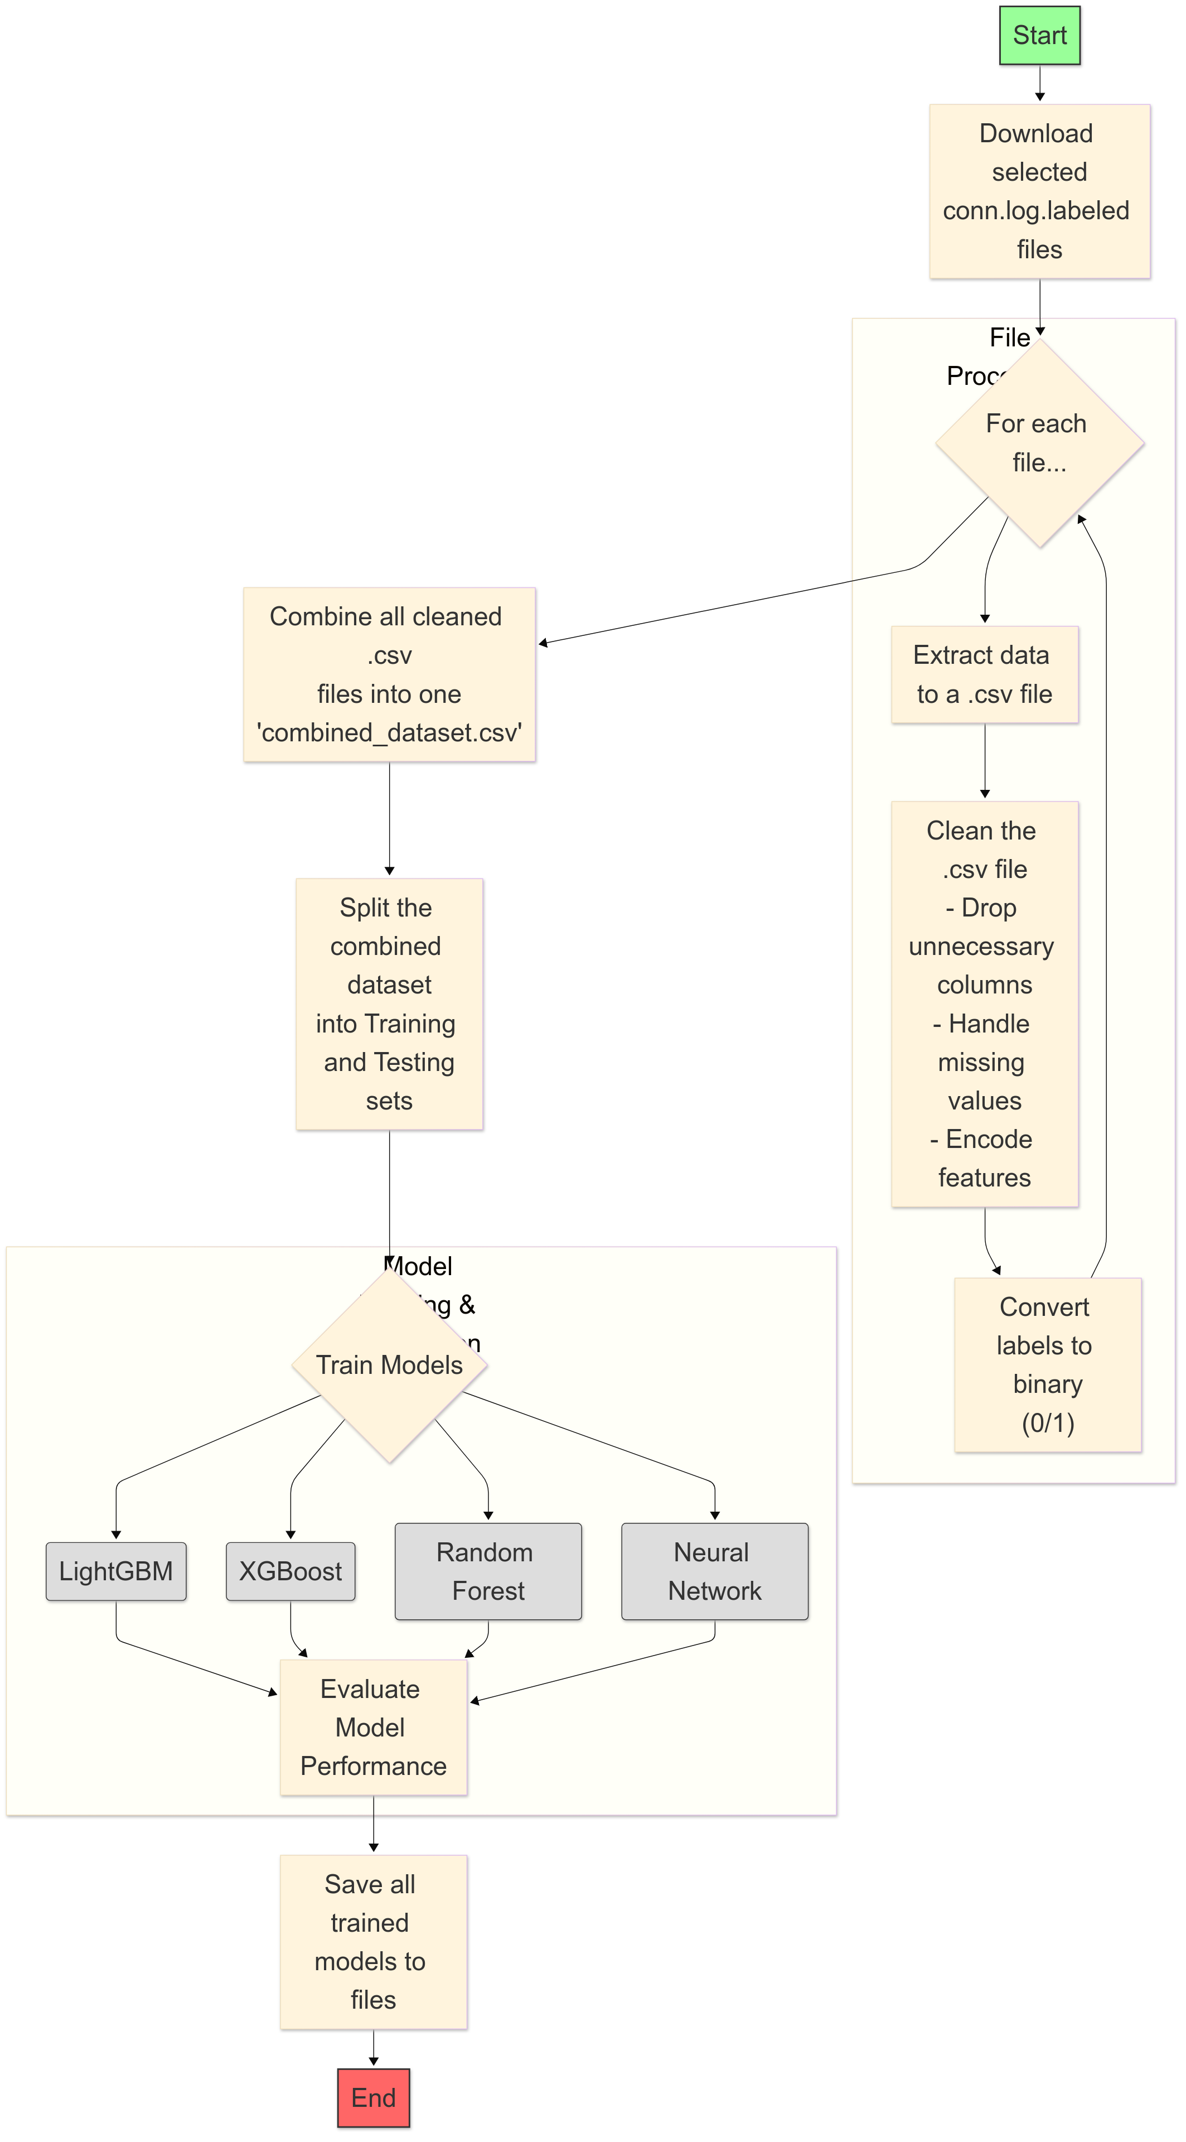
Training Flow Chart

Slide 6
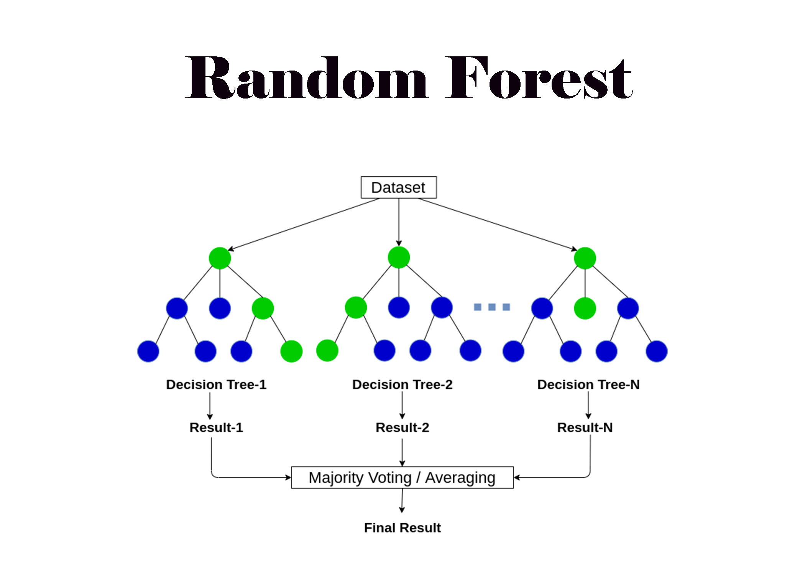

Slide 7
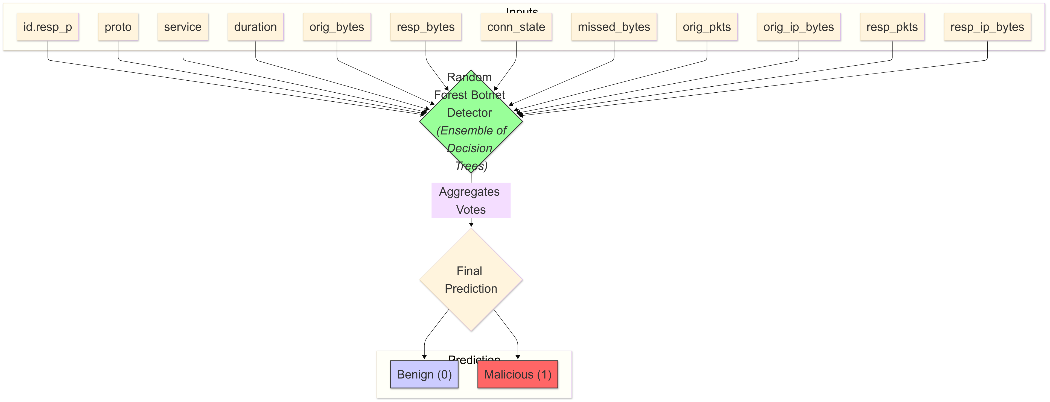
Random Forest

Slide 8
Hyperparameters
Hyperparameter | Value | Description
n_estimators | 200 | The number of trees in the forest.
max_depth | 20 | The maximum depth of each tree.
min_samples_split | 5 | The minimum number of samples required to split an internal node.
min_samples_leaf | 2 | The minimum number of samples required to be at a leaf node.
max_features | sqrt’ (default) | The number of features to consider when looking for the best split (sqrt of total features).
class_weight | balanced' | Adjusts weights inversely proportional to class frequencies to handle imbalance.
random_state | 42 | Seed used for reproducibility.

Slide 9
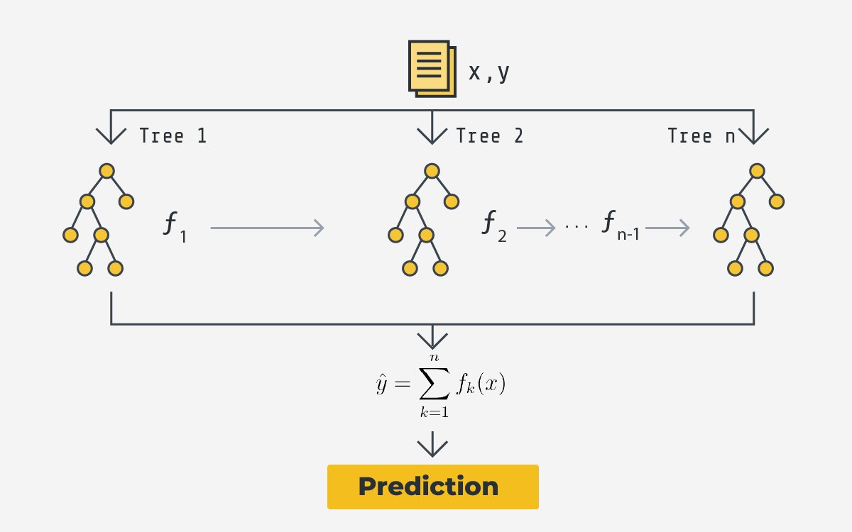
Xgboost

Slide 10
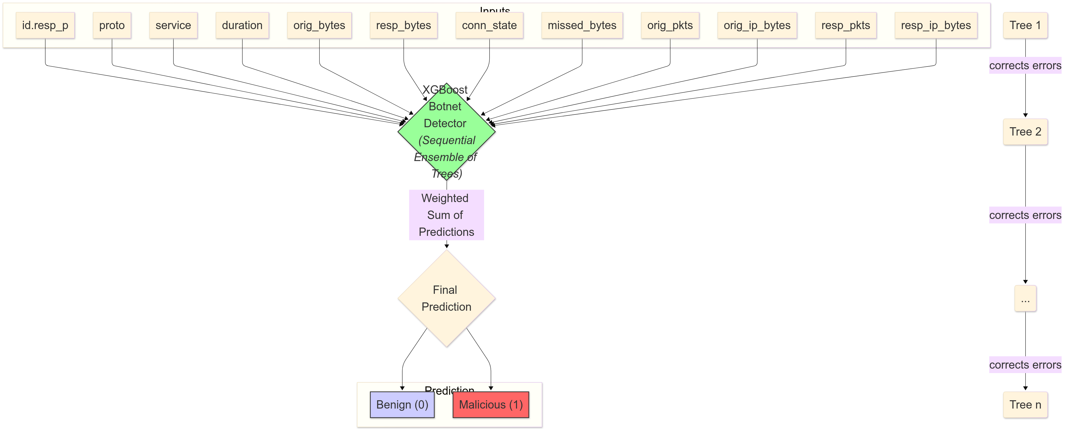
Xgboost

Slide 11
Hyperparameters
Hyperparameter | Value | Description
objective | binary:logistic' | Specifies the learning task is binary classification with logistic for probabilities.
eval_metric | logloss' | The evaluation metric used when training data for early stopping
use_label_encoder | FALSE | Disables the automatic label encoding by XGBoost.
random_state | 42 | Seed used for reproducibility.
n_jobs | -1 | Use all available CPU cores for training.
tree_method | hist' | Uses a faster, histogram-based algorithm for tree construction.

Slide 12
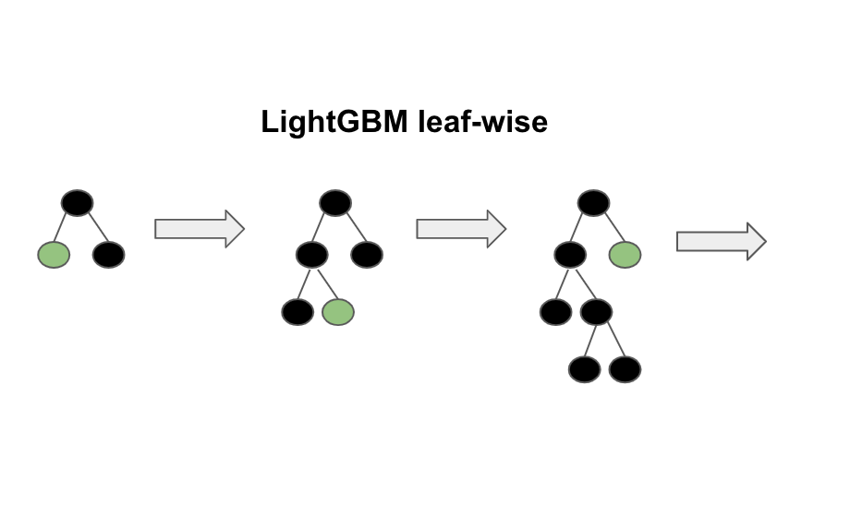

Slide 13
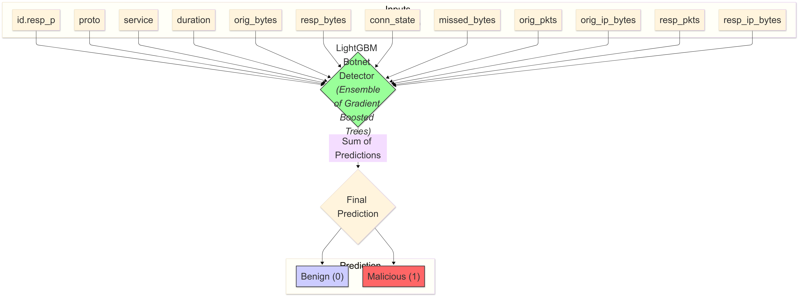
Lightgbm

Slide 14
Hyperparameters
Hyperparameter | Value | Description
objective | binary' | Specifies that the model is performing binary classification.
metric | auc' | The evaluation metric used is the Area Under the ROC Curve.
n_estimators | 1000 | The maximum number of boosting trees to be built.
learning_rate | 0.05 | The step size at each iteration while moving toward the minimum of a loss function.
num_leaves | 31(default) | The maximum number of leaves in one tree (the default value).
max_depth | -1 | No limit on the tree depth.
random_state | 42 | Seed used for reproducibility.
n_jobs | -1 | Use all available CPU cores for training.
colsample_bytree | 0.8 | Subsample ratio of columns when constructing each tree.
subsample | 0.8 | Subsample ratio of the training instance.
reg_alpha | 0.1 | L1 regularization term on weights.
reg_lambda | 0.1 | L2 regularization term on weights.

Slide 15
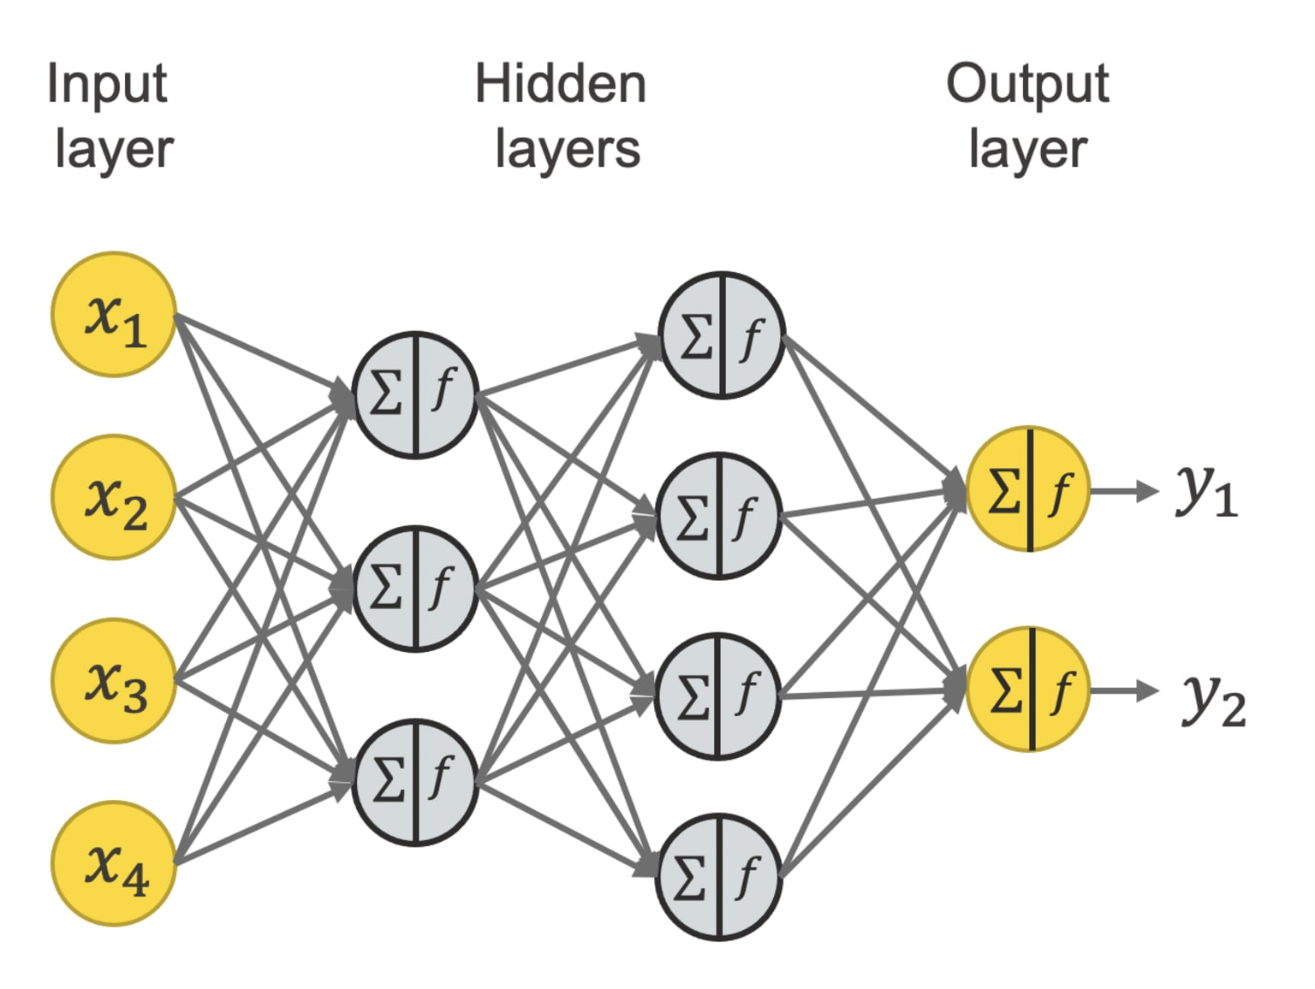
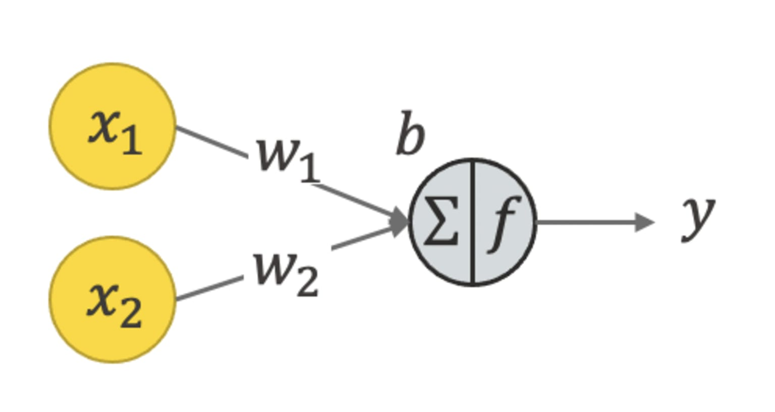
Neural Network

Slide 16
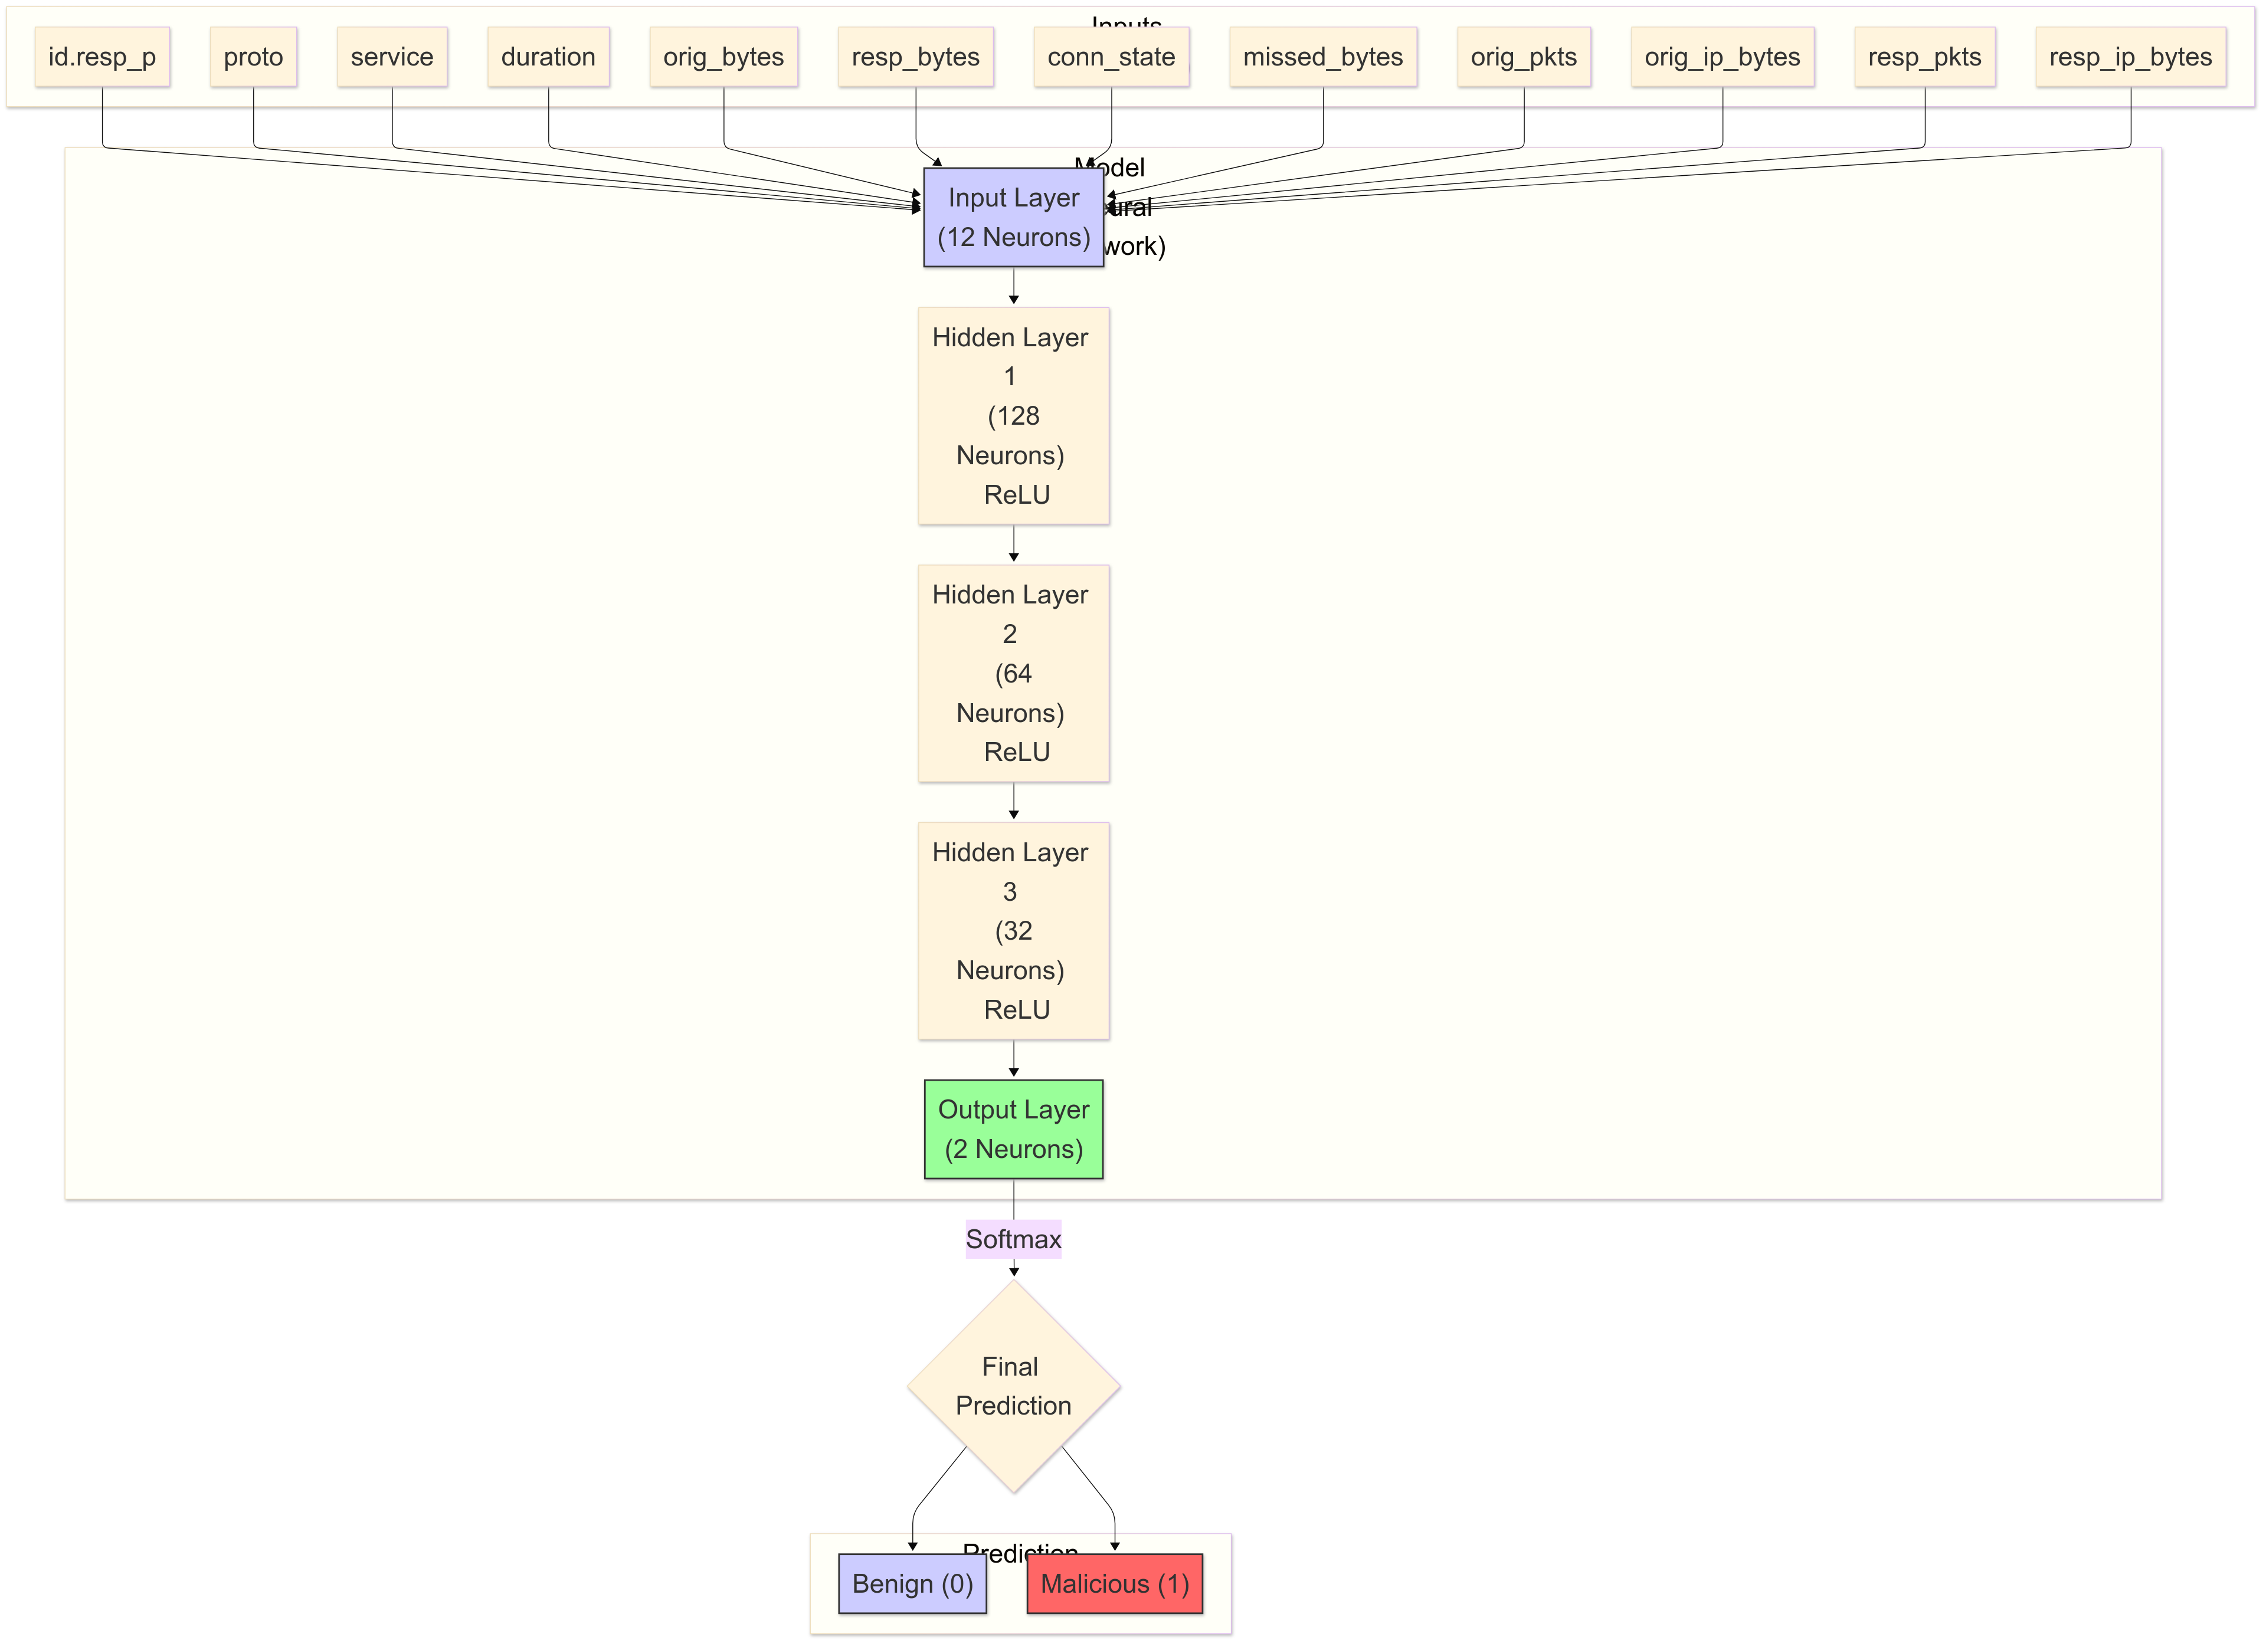
Neural Network

Slide 17
Hyperparameters
Parameter | Value | Description
Batch Size | 1024 | The number of samples processed before the model is updated.
Epochs | 50 | The maximum number of times the training dataset is passed through the model.
Loss Function | CrossEntropyLoss | Computes the cross-entropy loss between input logits and target.
Optimizer | Adam | An adaptive learning rate optimization algorithm.
Learning Rate | 0.001 | The initial learning rate for the Adam optimizer.
Weight Decay | 1.00E-05 | L2 penalty (regularization term) added to the loss function.
LR Scheduler | ReduceLROnPlateau | Reduces the learning rate when the validation loss has stopped improving.
Scheduler Patience | 3 | Number of epochs with no improvement after which the learning rate will be reduced.
Scheduler Factor | 0.5 | Factor by which the learning rate will be reduced (new_lr = lr * factor).
Early Stopping Patience | 5 | Number of epochs with no improvement in validation loss before training is stopped.

Slide 18





Tools Used

Slide 19
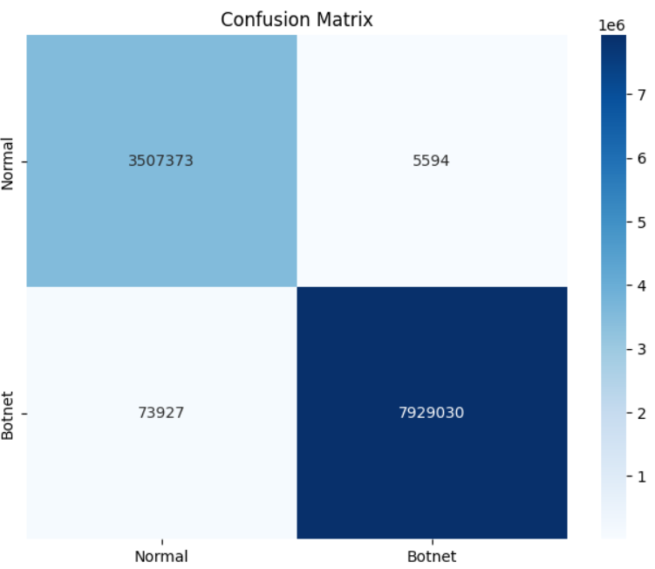
Xgboost confusion matrix

Slide 20
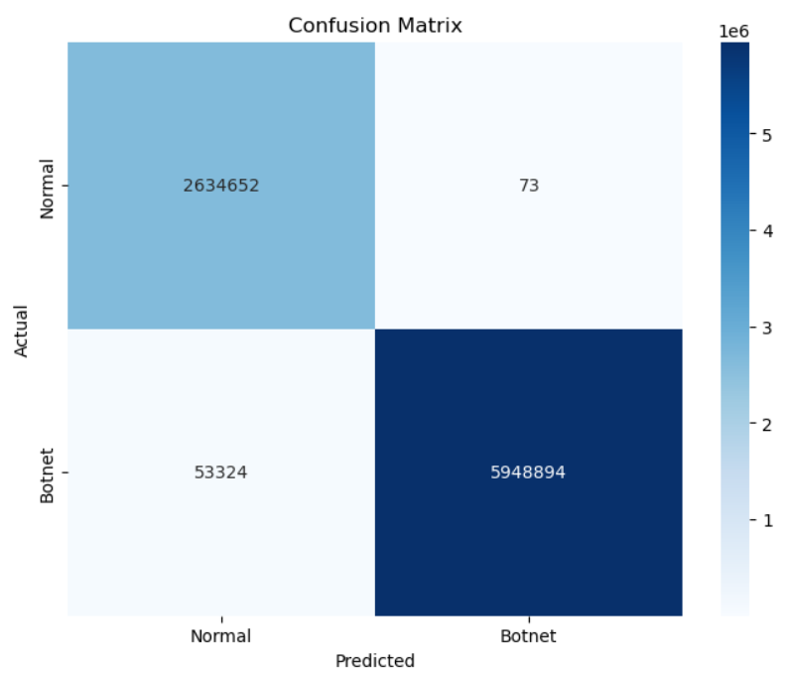
Random Forest confusion matrix

Slide 21
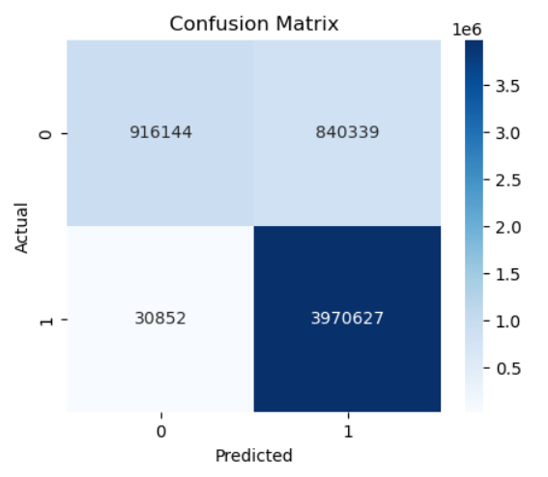
Neural network confusion matrix

Slide 22
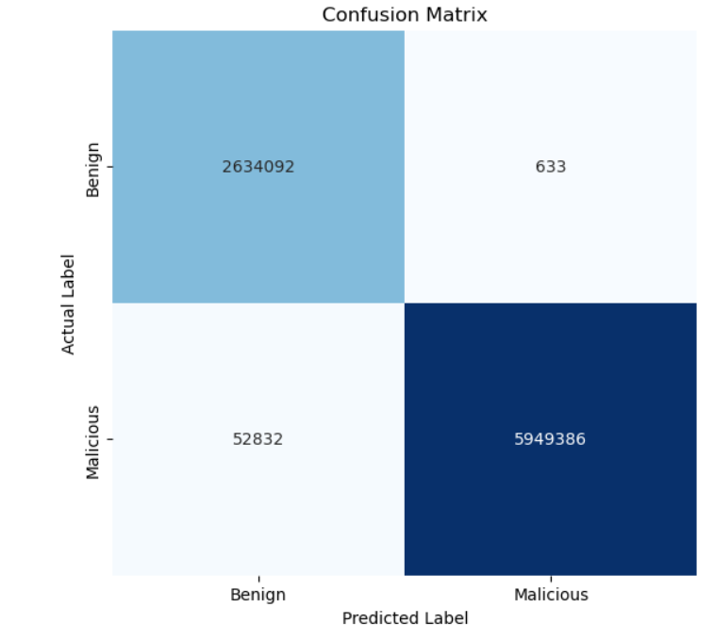
Light gbm confusion matrix

Slide 23
Model | Accuracy | Precision | Recall | F1-Score
Random Forest | 0.9938 | 1 | 0.9911 | 0.9955
XGBoost | 0.9931 | 0.9993 | 0.9908 | 0.9950
LightGBM | 0.9938 | 0.9999 | 0.9912 | 0.9955
Neural Network | 0.8487 | 0.8253 | 0.9923 | 0.9011
Evaluation metrics

Slide 24
Light gbm confusion matrix

Slide 25
LightGBM

Slide 26
Previous papers (Austin, 2021)
1,027,714 rows * 15 features
Random forest: باستخدام 50 شجرة قرار كل واحده بعمق 6 عقد.
Naïve Baes: واستخدم الGaussian naïve bayes
Support Vector Machine: واستخدم linear svm
Stochastic Gradient Descent: مصنف خطي تم تحسينه باستخدام SGD
Used these features: time of day, id.orig_p, id.resp_p, proto, service, duration, orig_bytes, resp_bytes, missed_bytes, history, orig_pkts, orig_ip_btes, resp_pkts, resp_ip_bytes, Label

Slide 27
Previous papers (Austin, 2021)
His results
Our results
Model | Accuracy | F1-Score | Precision | Recall
Random Forest | 97.45 | 97.39% | 99.92% | 94.98%
Naïve Bayes | 94.19% | 94.50% | 89.75% | 99.75%
Linear SVM | 91.72% | 92.33% | 85.85% | 99.90%
Stochastic Gradient Descent | 94.45% | 94.41% | 95.33% | 93.51%
Model | Accuracy | Precision | Recall | F1-Score
Random Forest | 0.9938 | 1 | 0.9911 | 0.9955
XGBoost | 0.9931 | 0.9993 | 0.9908 | 0.9950
LightGBM | 0.9938 | 0.9999 | 0.9912 | 0.9955
Neural Network | 0.8487 | 0.8253 | 0.9923 | 0.9011

Slide 28
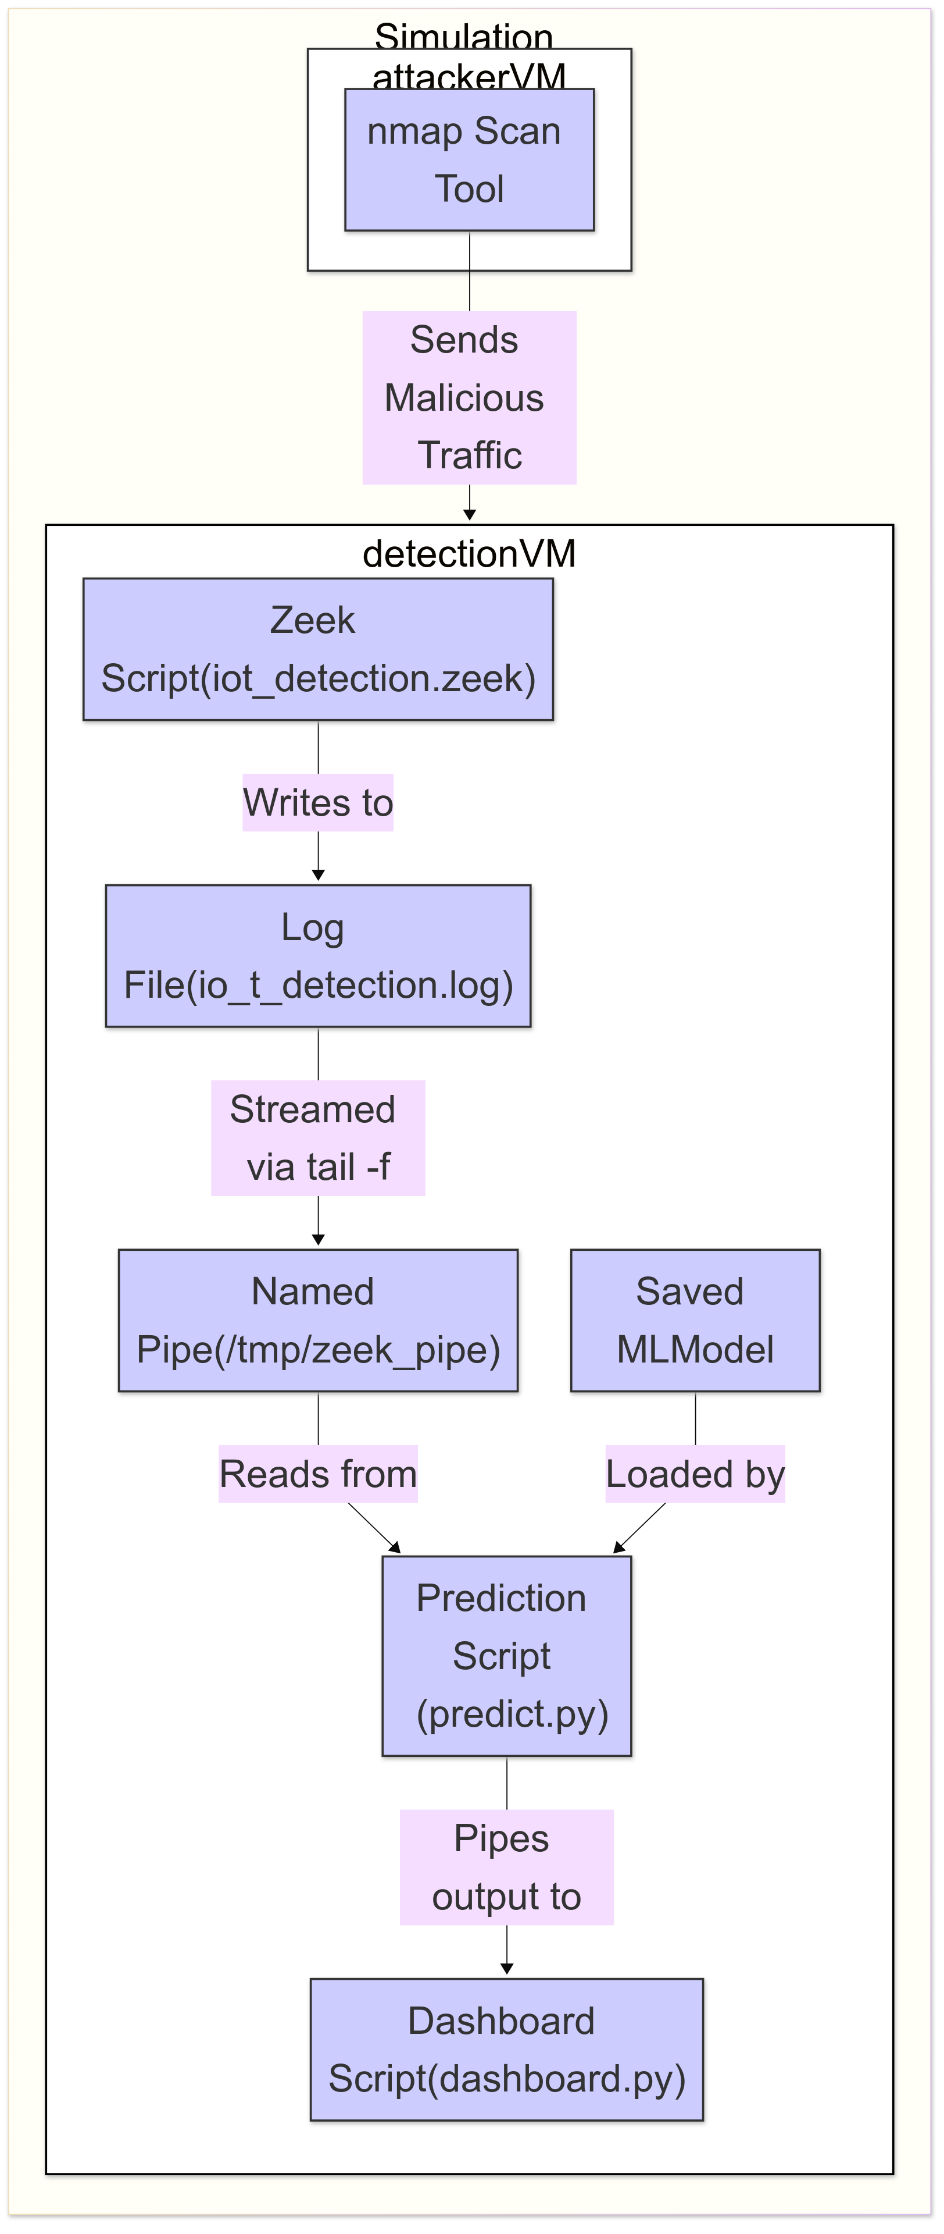
Simulation
Video

Slide 29
Thanks

